Slide 1
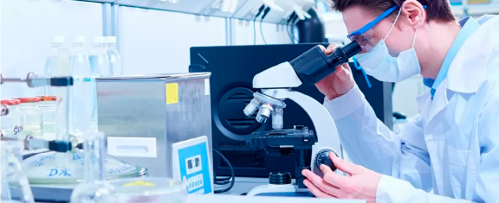
NATIONAL MANUFACTURER OF IMMUNOBIOLOGICAL MEDICINES

Slide 2
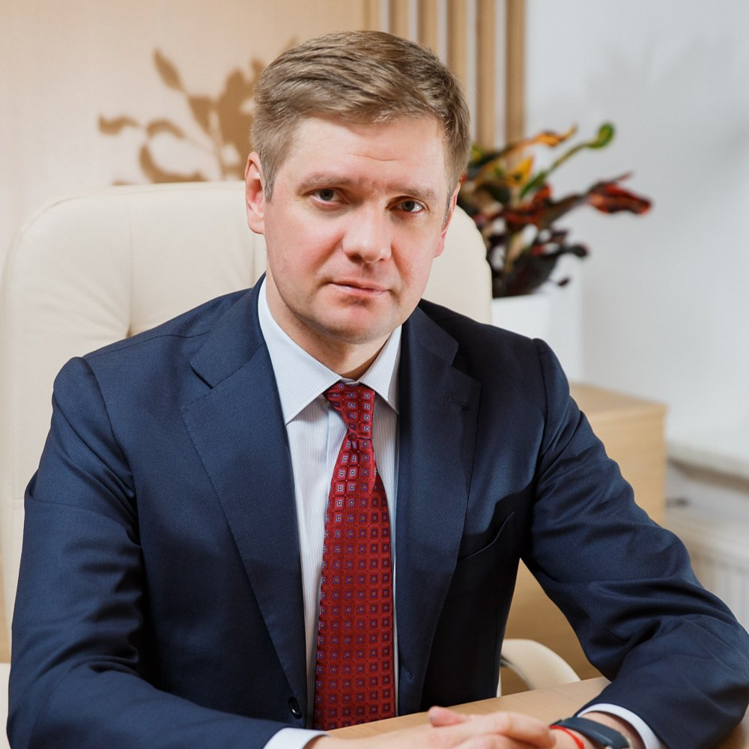
Andrey Yurievich Zagorskiy
General Director of Nacimbio JSC — the managing organization of SPA Microgen JSC
«
SPA Microgen JSC is a key competence center in the development and manufacture of Russian immunobiological medicines, which pioneered the development of biopharmaceutical technologies in our country and creates innovations today.
Our most important goal is to develop a portfolio of medicinal products that meets the requirements of the modern Russian healthcare for protection of the health of citizens.
»

Slide 3
HISTORY OF DEVELOPMENT
More than 120 years of development
of immunobiotechnologies in Russia
2015
Transfer of 100 % of the shares of the company to Rostec State Corporation, transfer by Rostec State Corporation of the powers of the sole executive body of SPA Microgen to Nacimbio
1920
Foundation of the Omsk Enterprise for Manufacture of Bacterial Products and Imbio (Nizhny Novgorod)
1950
Foundation of SPA Nutrient Media (Makhachkala) and Moscow Subdivision for Manufacture of Bacterial Products (Moscow)
2003
Merger of enterprises into SPA Microgen
1890
Foundation
SPA Virion (Tomsk), SPA Biomed (Perm),
Immunopreparat (Ufa)
1910
Foundation of Allergen (Stavropol)
2020
Launch of combined measles, rubella, and mumps vaccine
Vaktrivir, vaccines for the prevention of diphtheria, tetanus, whopping cough — aDTwP-Hep-B+Hib
2000
Launch of rubella, influenza, combined vaccines and botulinum toxin type A vaccines
1980
Launch of tick-born encephalitis vaccine
1930
Launch of antitetanic serum, DTwP, dysentery bacteriophage, monophages
1890
Launch of antidiphteric serum, rabies and smallpox vaccines
1960
Launch of allergens, blood products, measles and mumps vaccines, dry smallpox vaccine, bifidumbacterin
1990
Launch of Sextaphag and Intesti-bacteriophage
Key corporate events
Key events in portfolio development

Slide 4
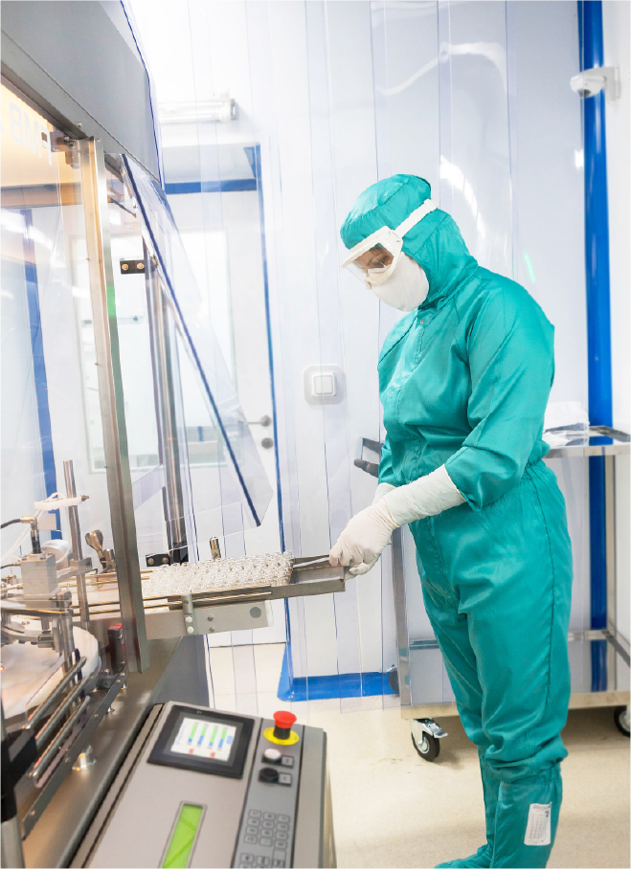
COMPANY'S MISSION
To supply the population of the Russian Federation with vital immunobiological medicines, their full-cycle development and production

Slide 5
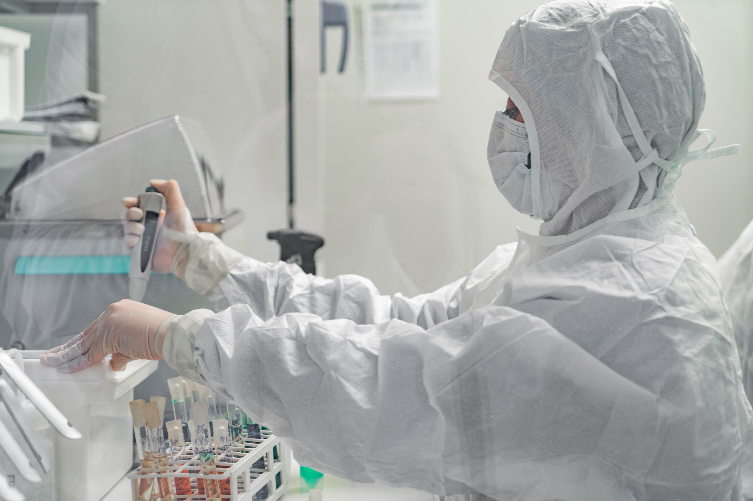
STRATEGIC AREAS OF THE COMPANY'S DEVELOPMENT
Improvement of production sites and processes for high-quality immunobiological medicines production in full compliance with the current regulatory requirements
Development of new immunobiological medicines that meet the current needs of the country's population
Launch of new, consumer-friendly dosage forms of existing immunobiological medicines into civil circulation
Expansion of the indications for use of immunobiological medicines to cover socially significant diseases with an effective therapy

Slide 6
ABOUT THE COMPANY
8
production sites
More than 5,000
employees
More than 250
titles of medicines and diagnostic products
More than 15,000,000 packages — production capacity
5 laboratories
11 exporting countries
Supply of medicines
that have no analogues
at the foreign markets
More than 300
vehicles for federal cold chain supplies

Slide 7
GEOGRAPHY OF THE COMPANY'S ACTIVITIES
8
Moscow
Moscow Subdivision for Manufacture of Bacterial Products
Nizhny Novgorod
IMBIO
Stavropol
Allergen
Perm
Biomed
Ufa
Immunopreparat
Tomsk
SPA Virion
Omsk
Omsk Enterprise for Manufacture of Bacterial Products
Makhachkala
SPA Nutrient Media
PRODUCTION SITES
Moscow
Nizhny Novgorod
Perm
Ufa
Stavropol
Tomsk
Makhachkala
Omsk

Slide 8
MAIN GROUPS OF MEDICINES
Vaccines and anatoxins
Blood preparations
Bacteriophages
Botulinum toxin type A (Relatox)
OTHER MEDICINES
Probiotics
Allergens and allergoids
Ready-made medicines
Diagnostic drugs and nutritional products
Heterologous sera

Slide 9
VACCINES AND ANATOXINS
SPA Microgen JSC accounts for about 40 % of the country's demand for vaccines and anatoxins
out of 17 NIS vaccines*
11 are supplied by the company
20 VACCINES
for prevention of 15 infectious diseases
MORE THAN 50
million doses — vaccines production per year
Sovigripp
АDT-anatoxin, ADT-R-anatoxin
BCG, BCG-M
DTwP vaccine
Mumps and measles vaccine
Rubella vaccine
AT-anatoxin
Measles vaccine
DTwP-Hep B vaccine
AD-R-anatoxin
Mumps vaccine
*National Immunization Schedule

Slide 10
VACCINES AND ANATOXINS
The company is constantly developing new products
5 VACCINES ARE BEING DEVELOPED:
Antirabiс vaccine based on Vero split cell line
Smallpox vaccine based on Vero split cell line
Tick-borne encephalitis vaccine based on Vero split cell line
DTwP-Hep B+Hib (CSs are completed, RC is to be issued by the end of the year)
aDTwP-M (booster)
NEW PRODUCTS:
Combined vaccine against measles, rubella and mumps-culture live — Vaktrivir
Vaccine for the prevention of diphtheria, tetanus, pertussis (cell-free), hepatitis B and infection caused by Haemophilus influenzae type b — aDTwP-Hep-B+Hib
Meningococcal A, C polysaccharide vaccine

Slide 11
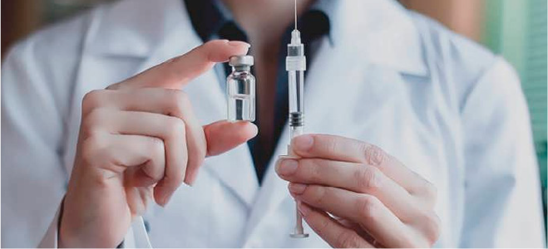
VAKTRIVIR
1 injection for prevention of 3 infectious diseases:
The only domestic three-component combined vaccine against measles, rubella, and mumps
measles
rubella
mumps
The vaccine was registered in 2019
From 2020, SPA Microgen JSC plans to launch Vaktrivir into civil circulation. Currently, for the prevention of measles, rubella and mumps, the Ministry of Health of the Russian Federation annually purchases single-component vaccines against these infections within the NIS**. Should a need for an MMR vaccine arise, SPA Microgen JSC will be able to supply Vactrivir in the appropriate amount to cover the required number of people to be immunized starting from 2022.
Advantages of Vactrivir:
Clinically proven low reactogenicity in children
The use of three-component combination vaccines increases the adherence to immunization and reduces the injection load.
The only vaccine in the Russian Federation based on the culture of quail embryo fibroblast cells
The use of QEF cell culture for production of the vaccine eliminates the risk of immediate anaphylactic hypersensitivity reactions to chicken protein
* National Immunization Schedule (Order of the Ministry of Health of the Russian Federation No. 125n dd. 21.03.2014)
Currently, the transition to combined vaccines and an increase in the number of their components are a common trend in the development of vaccine prevention in the world.

Slide 12
ENCEVIR
ENCEVIR® vaccine is a highly efficient and safe medicine for prevention of tick-borne encephalitis
ENCEVIR NEO FOR CHILDREN
Specific prevention in children starting from 3 years of age* up to 17 years (inclusive)
ENCEVIR
Specific prevention of tick-borne encephalitis in individuals starting from 18 years of age
Immunization of donors in order to obtain a specific immunoglobulin
Advantages of Encevir:
Protects against strains of the European and Far Eastern virus genotypes
High immune protection when using an accelerated immunization regimen
Scientific research is being conducted to develop a technology for production of an anti-tick vaccine based on Vero split cell line
Preventive immunization against tick-borne viral encephalitis in Russia is carried out according to epidemic indications.
Immunobiological medicines included in the ISEI** are included into the List of VEMMU*** for 2020.
* It is planned to expand the indications for use for children starting from 12 months of age
** Immunization Schedule for Epidemic Indications (Order of the Ministry of Health of the Russian Federation No. 125n dd. 21.03.2014)
*** List of vital and essential medicines for medical use for 2020 (Order of the Government of the Russian Federation No. 2406-р dd.12.10.2019)

Slide 13
SOVIGRIPP
RESEARCH
According to a large-scale epidemiological study conducted by the Consulting and Diagnostic Center of G. N. Gabrichevsky MRIEM with a total population of exceeding 15 thousand people, the vaccine showed:
high epidemiological efficiency
high tolerability and safety
compliance with the immunogenicity criteria for inactivated influenza vaccines adopted in the European Union and the Russian Federation
Trivalent inactivated subunit influenza vaccine
It has been marketed since 2013 and is supplied annually within the NIS for immunization of children and adults
Advantages
It is intended for immunization of children starting from 6 months of age, adults without age restriction, pregnant women in the II-III trimester
Clinically proven high immunogenicity and safety
The use of the vaccine for a several years provided for a consistently low level of influenza incidence
DYNAMICS OF INFLUENZA INCIDENCE AND NUMBER OF THE IMMUNIZED AGAINST INFLUENZA IN 2019-2020Г ​(% OF POPULATION)​
Number of the immunizedс
* Pursuant to the resolution of the Chief State Sanitary Doctor of the Russian Federation No. 38 dd. 25.06.2018 on influenza and acute respiratory viral infections prevention measures in the epidemic season 2018-2019.
** official influenza incidence data for 2020 will be published in the first quarter of 2021.

Slide 14
BLOOD PREPARATIONS
SPA Microgen JSC covers about 20 % of the country's demand for albumin and normal immunoglobulin
200 TONS
plasma processing volume
SOLE MANUFACTURER OF 5 SPECIFIC IMMUNOGLOBULINS:
antistaphylococcal
against tick-borne encephalitis
anti-allergic
antitetanic
against hepatitis B
4 unique
heterologous sera for passive immunization against dangerous infections:
antibotulinum
antigangrenous
antidiphtheria
antitetanic
2 MEDICINES ARE BEING DEVELOPED
Normal human immunoglobulin — BioGam
Specific immunoglobulin against hepatitis B — AntihepNeo
Industrial production of immunoglobulins using chromatography methods is planned.
The technology of blood products production includes stages that provide for additional viral safety of the manufactured medicines

Slide 15
BACTERIOPHAGES
SPA Microgen JSC is the sole manufacturer of bacteriophages on the territory of the Russian Federation
11 TITLES
1.8 MILLION PACKAGES
80 YEARS OF SUCCESSFUL USE
Bacteriophages by SPA Microgen JSC are used to prevent possible mass outbreaks of infectious diseases in flood areas, as well as in emergency situations caused by floods
NEW MEDICINES BEING DEVELOPED
Difag
Enterobacter
New bacteriophage cocktails
NEW DOSAGE FORMS
being developed: capsules, spray, gel, wound sponges, suppositories
ADVANTAGES:
Targeted to destroy pathogenic bacteria, preserving the normal microflora
Non-toxic and cause no side effects
Eliminated from the body after destruction of the pathogenic agent
Constant updating of the strain collection
Strategy for prevention of the spread of antimicrobial resistance in the Russian Federation for the period up to 2030*.
One of the areas to solve the problem of antibiotic resistance is the need to develop alternative means of prevention and treatment of infectious diseases, including bacteriophages
Strategy for the healthcare development in the Russian Federation for the period up to 2025**.
Prevention of the spread of antimicrobial resistance has been identified as one of the priorities in healthcare development
* Order of the Government of the Russian Federation No. 2045-r dd. 25.09.2017
** Decree of the President of the Russian Federation No. 254 dd. 06.06.2019

Slide 16
ANTIBACTERIAL ACTIVITY OF BACTERIOPHAGES
BACTERIOPHAGES | Staphilococcus | Streptococcus | Enterococcus | Proteus vulgaris | Proteus mirabilis | Pseudomonas aeruginosa | Enteropathogenic Esherichia coli | Klebsiella pneumoniae | Klebsiella oxytoca | Klebsiella ozaenae | Klebsiella rhinoscleromatis | Shigella flexneri of 1, 2, 3, 4, 6 serovars, Shigella sonnei | Salmonella paratyphi A, B, typhimurium, choleraesuis, infantis, oranienburg, enteriritidis
Complex pyobacteriophage | ✓ | ✓ | ✓ | ✓ | ✓ | ✓ | ✓ | ✓ | ✓ | ✓ | ✓ | ✓ | ✓
Intesti® - bacteriophage | ✓ | ✓ | ✓ | ✓ | ✓ | ✓ | ✓ | ✓ | ✓ | ✓ | ✓ | ✓ | ✓
Sextape® Polyvalent pyobacteriophage | ✓ | ✓ | ✓ | ✓ | ✓ | ✓ | ✓ | ✓ | ✓ | ✓ | ✓ | ✓ | ✓
Coli proteus bacteriophage | ✓ | ✓ | ✓ | ✓ | ✓ | ✓ | ✓ | ✓ | ✓ | ✓ | ✓ | ✓ | ✓
Polyvalent purified klebsiella bacteriophage | ✓ | ✓ | ✓ | ✓ | ✓ | ✓ | ✓ | ✓ | ✓ | ✓ | ✓ | ✓ | ✓
Proteus bacteriophage | ✓ | ✓ | ✓ | ✓ | ✓ | ✓ | ✓ | ✓ | ✓ | ✓ | ✓ | ✓ | ✓
Staphylococcal bacteriophage | ✓ | ✓ | ✓ | ✓ | ✓ | ✓ | ✓ | ✓ | ✓ | ✓ | ✓ | ✓ | ✓
Streptococcal bacteriophage | ✓ | ✓ | ✓ | ✓ | ✓ | ✓ | ✓ | ✓ | ✓ | ✓ | ✓ | ✓ | ✓
Bacteriophage Pseudomonas aeruginosa (pyocyanic) | ✓ | ✓ | ✓ | ✓ | ✓ | ✓ | ✓ | ✓ | ✓ | ✓ | ✓ | ✓ | ✓
Coli bacteriophage | ✓ | ✓ | ✓ | ✓ | ✓ | ✓ | ✓ | ✓ | ✓ | ✓ | ✓ | ✓ | ✓
Klebsiella Pneumoniae purified bacteriophage | ✓ | ✓ | ✓ | ✓ | ✓ | ✓ | ✓ | ✓ | ✓ | ✓ | ✓ | ✓ | ✓
Dysentery polyvalent bacteriophage | ✓ | ✓ | ✓ | ✓ | ✓ | ✓ | ✓ | ✓ | ✓ | ✓ | ✓ | ✓ | ✓
Salmonella bacteriophage of A, B, C, D, E groups | ✓ | ✓ | ✓ | ✓ | ✓ | ✓ | ✓ | ✓ | ✓ | ✓ | ✓ | ✓ | ✓

Slide 17
SEXTAPHAG® AND INTESTI® BACTERIOPHAGE
The therapeutic efficacy and tolerability have been proven in observational studies*, as well as confirmed in the course of clinical use (more than 25 years)
SEKSTAPHAGE®
safe alternative to antibiotics
Treatment and prevention of purulent-inflammatory and enteral diseases caused by Staphylococci, Streptococci, Proteus, Klebsiella, Pseudomonas aeruginosa and Escherichia coli:
Diseases of the ear, throat, nose, respiratory tract and lungs
Surgical infections
Urogenital infections
Conjunctivitis
Gastroenterocolitis, cholecystitis
Generalized septic diseases
INTESTI®-BACTERIOPHAGE
assistance in treatment and prevention of gastrointestinal diseases caused by dysentery bacteria, Salmonella, Escherichia coli, Enterococci, Staphylococci, Pseudomanas aeruginosa or their combination:
Bacterial dysentery
Salmonellosis
Dyspepsia
Dysbacteriosis
Enterocolitis, colitis
Advantages of Intesti®-bacteriophage:
Effective against the main pathogens of acute intestinal infections (dysentery, salmonellosis, enterocolitis)
Used for the prevention of diseases in areas of natural disasters and in foci of intestinal infections
Suitable for children starting from birth, pregnant women and the elderly
Can be combined with other drugs, including antibiotics
Advantages of Sextape®:
Effective against the main pathogens of diseases of the upper respiratory tract (inflammation of sinuses, otitis, tonsillitis, pharyngitis, laryngitis).
Suitable for children starting from birth, pregnant women and the elderly.
Can be combined with other drugs, including antibiotics
* A. I. Kryukov, A. V. Gurov, G. N. Izotova, E. G. Lapenko. The results of the observational (non-interventional) study "Analysis of the Therapeutic Efficiency of Polyvalent Pyobacteriophage Medicine (Sextaphage) for Acute Purulent Sinusitis". Bulletin of Otorhinolaryngology. 2019;84(5): 55-60

Slide 18
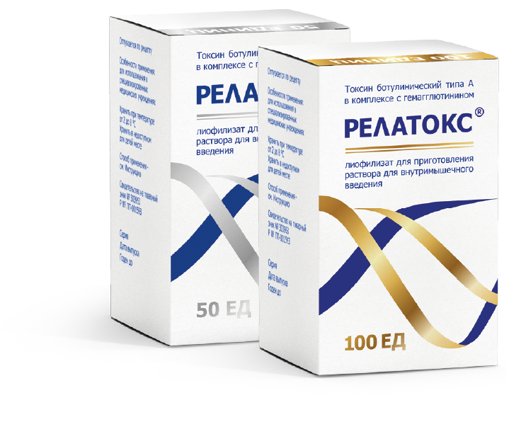
BOTULINUM TOXIN TYPE A (RELATOX®)
The first Russian botulinum toxin type A successfully used in aesthetic medicine, pediatric and adult neurology
1.6 MILLION PATIENTS
received botulinum therapy with Relatox
6,500 DOCTORS
use Relatox in their daily practice
7 YEARS
of successful use in aesthetic cosmetology
Advantages of Relatox:
Efficacy, tolerability, and safety non-inferior with the imported botulinum toxins
Long effect
High safety profile, hypoallergenic, due to the non-albumin stabilizing composition
Full production cycle in the Russian Federation that ensures stable supply and affordable price offer
The company conducts clinical studies to expand the indications:
Focal spasticity of the lower / upper extremity
Chronic migraine
Cervical dystonia (spastic torticollis)
Neck wrinkles

Slide 19
ALLERGENS AND ALLERGOIDS
SPA Microgen JSC is the sole manufacturer of diagnostic and therapeutic allergens and allergoids in the Russian Federation
Currently, allergens and allergoids produced by SPA Microgen JSC are used primarily for diagnostics.
For the development of the market potential of allergens in the ASIT (allergen-specific immunotherapy) segment, the following promising areas of production have been identified:
bringing pollen allergen preparations in compliance with the requirements of the State Pharmacopoeia of the XIV edition;
production and certification of standard samples (SS) of preparations of pollen allergens of the enterprise;
introduction of new methods for monitoring and standardization of allergenic drugs according to the composition and allergenic activity;
no human tests for quality assessment and release to the medical network (compliance with the requirements of Law No. 61-ФЗ "On the Circulation of Medicines")
WIDE RANGE OF ALLERGENS FOR DIAGNOSTICS AND ALLERGENSPECIFIC IMMUNOTHERAPY:
Pollen allergens
Food allergens
Epidermal allergens
Tick-borne allergens
ASIT (ALLERGEN SPECIFIC IMMUNOTHERAPY) is the only pathogenetic way to treat allergies
Advantages of ASIT:
long remission after the course of ASIT;
prevention of the transition of milder clinical manifestations of allergies (for example, rhinitis) to more severe ones (bronchial asthma);
reduced need for symptomatic allergy treatment after 1-2 years of therapy;
prevention of polysensitization to other allergens

Slide 20
EVENTS AND ACHIEVEMENTS
Along with research
and production activities,
SPA Microgen JSC actively implements educational and training projects
More than 150 master classes per year
in aesthetic medicine and neurology
Coverage of 30 Russian cities
More than 220 training events per year:
webinars, seminars, round tables, FCME
Audience of 16,000 doctors
Participation in specialized conferences and congresses
46+ federal events per year
in the following areas: infectious diseases, epidemiology, ENT, urology, ynecology, gastroenterology, surgery
57+ botulinum therapy events
17+ immunization activities

Slide 21
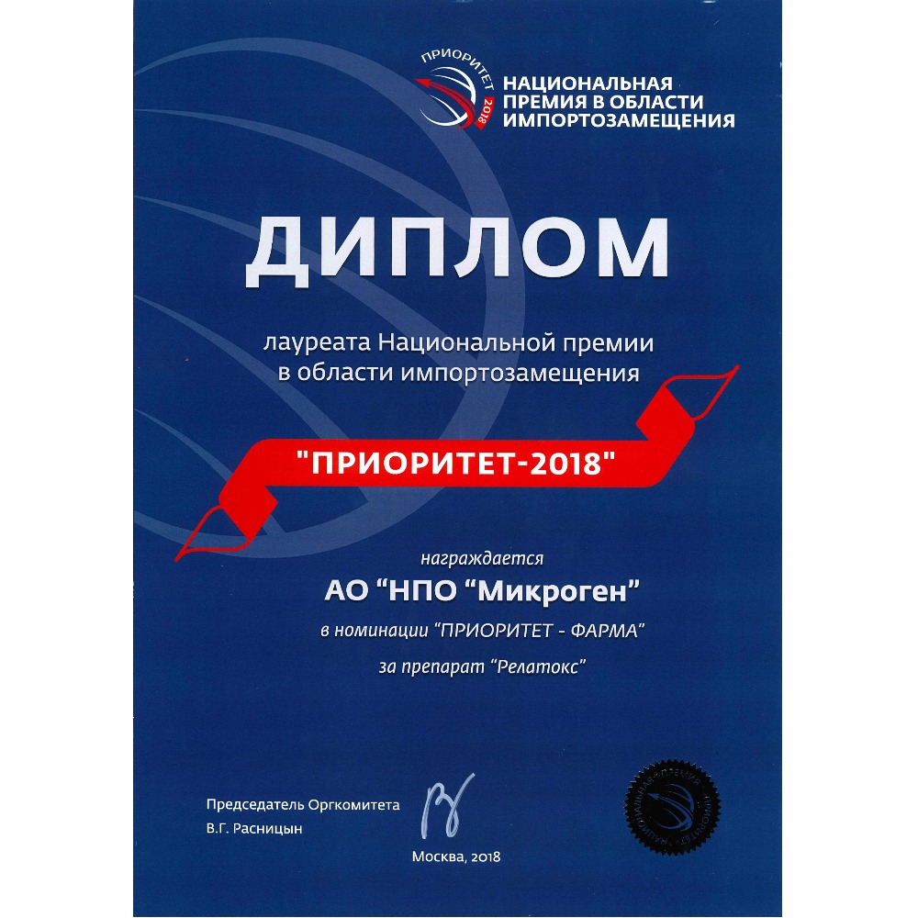
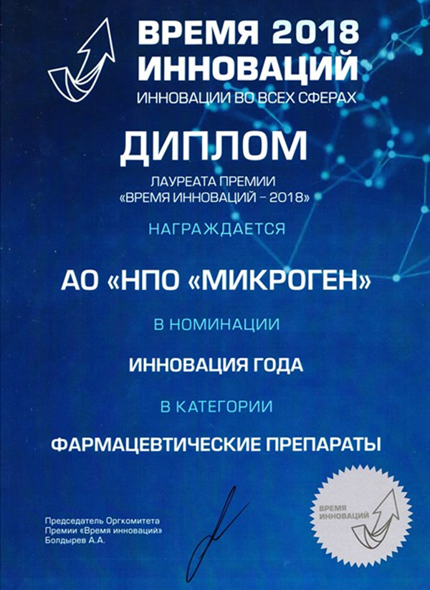
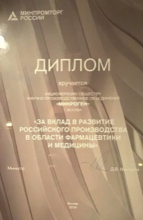
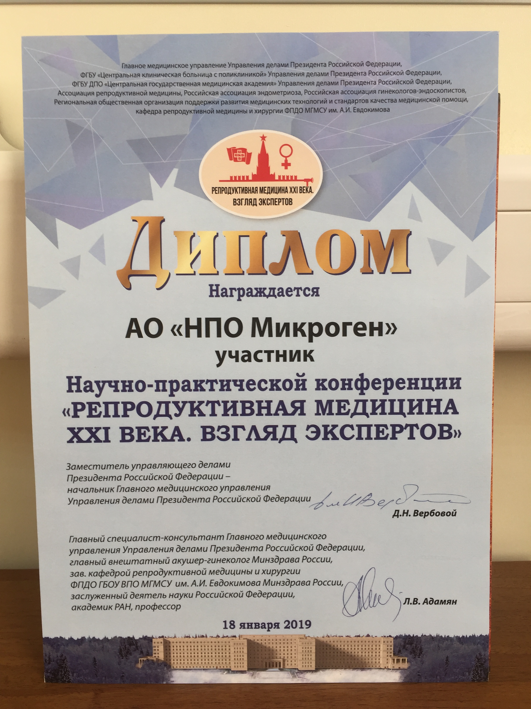
SPA MICROGEN JSC
IN THE COURSE OF ITS DEVELOPMENT
HAS REPEATEDLY BECAME
THE WINNER OF NATIONAL
COMPETITIONS AND RECEIVED
GOVERNMENT AWARDS
SPA Microgen JSC has been awarded for the development of domestic pharmaceutical production in the area of pharmaceuticals and medicine
Winner of the "Time of Innovation-2018" Award for the development of five-component vaccines
Winner of the National Award in the area of import substitution "Priority-2018" — the first Russian botulinum toxin Relatox
SPA Microgen JSC has been awarded for its contribution to the improvement of health of employees of the military-industrial complex
Winner of the National Award in the area of import substitution and technology transfer "Priority – 2019" of three-component vaccine "Vaktrivir"
Winner of the All-Russian Award in import substitution "Project Leader"
Winner of the All-Russian Award in import substitution "Project Leader" in the category "Medicine"

